Slide 1
Cognitive Modeling: Timing with Neural Networks
Thanks to Joost de Jong for his input

Slide 2
Limitations of many models
They work with discrete actions
ACT-R: production rules
Even most neural networks calculate activation in discrete time steps
The brain is a dynamical system, and time is an inherent feature of dynamical systems

Slide 3
How can neural networks represent time?
Spiking artificial neurons
Standard artificial neurons

Slide 4
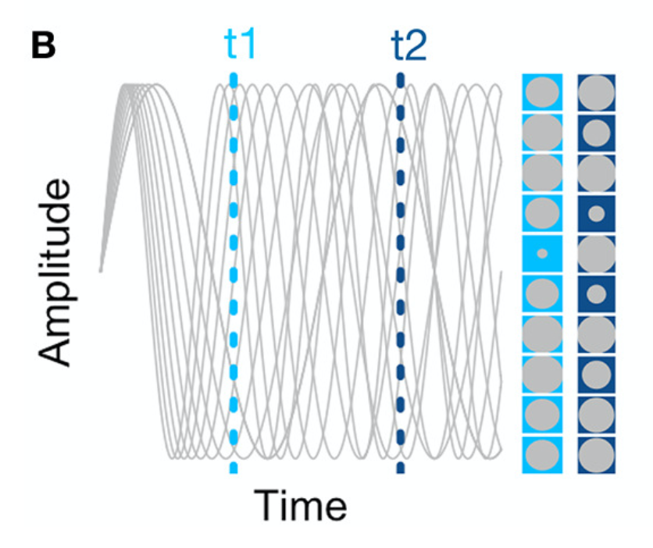
Striatal Beat Frequency model (Buhusi & Meck, 2005)

Slide 5
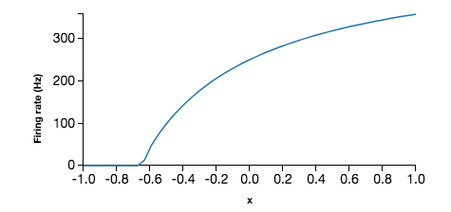
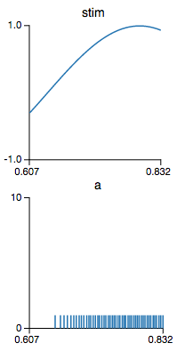
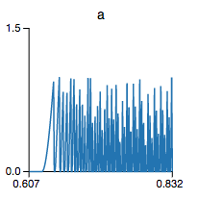
How can we represent values?
Leaky Integrate-and-Fire Neuron
Tuning Curve
input
voltage
spikes
time
time
Notes:
Can’t represent < .6
Noisy representation
Need some time to read out representation

Slide 6
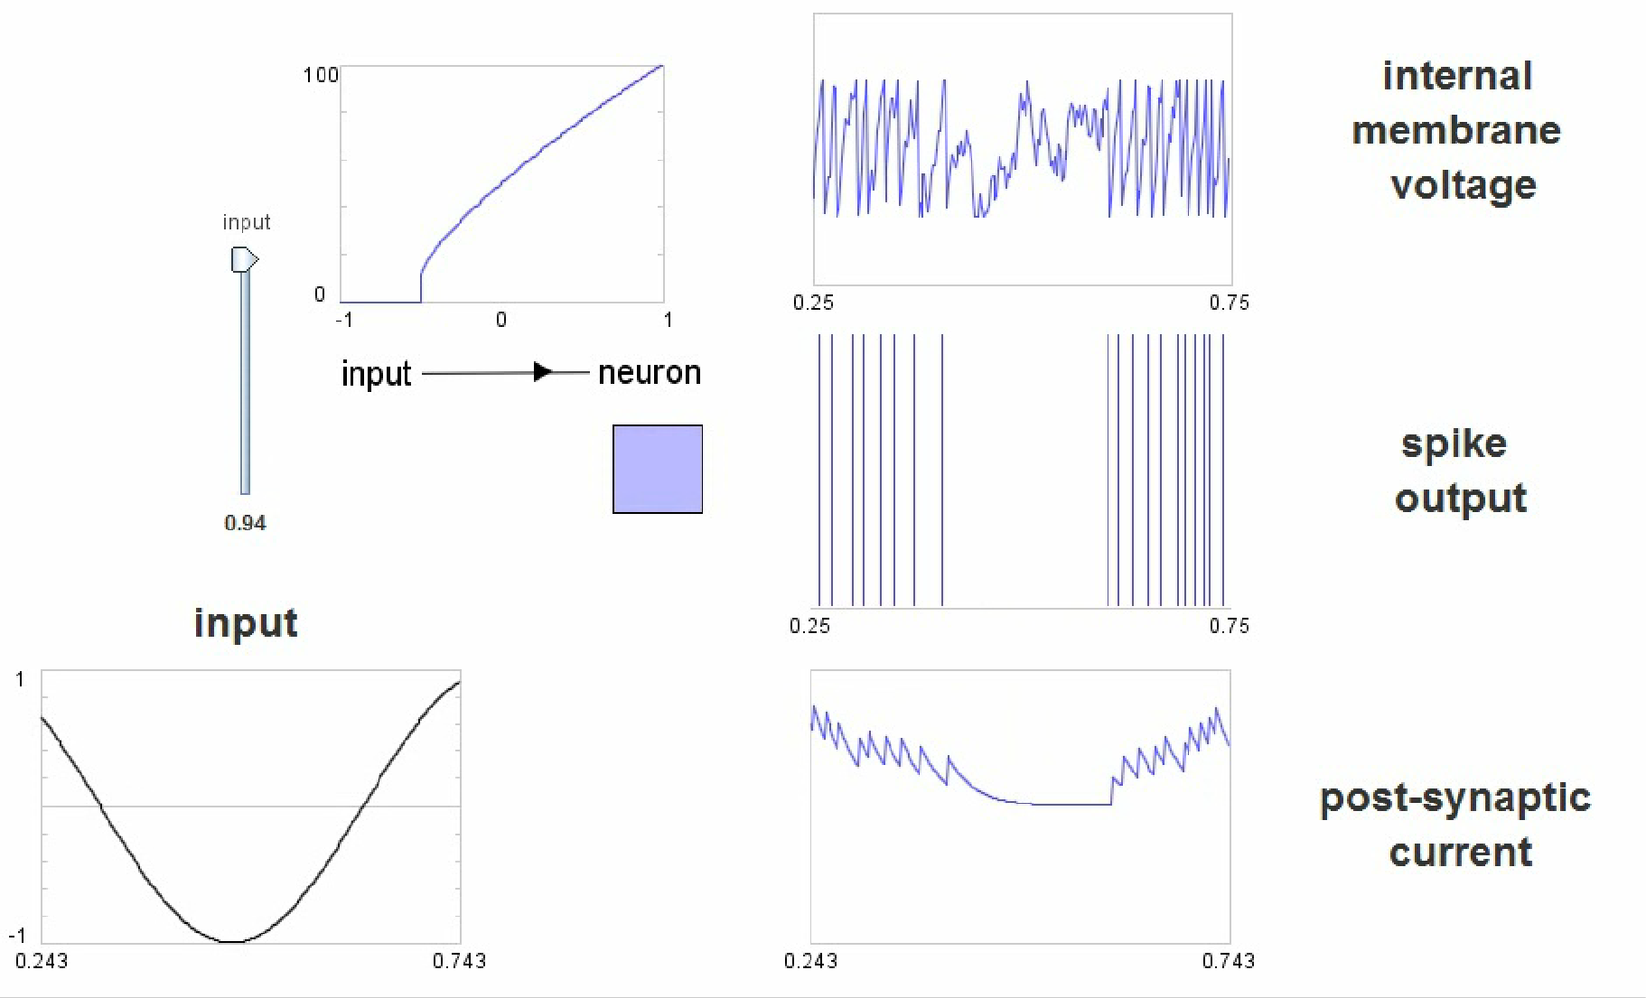
Single Neuron
Tuning Curve
Output

Slide 7
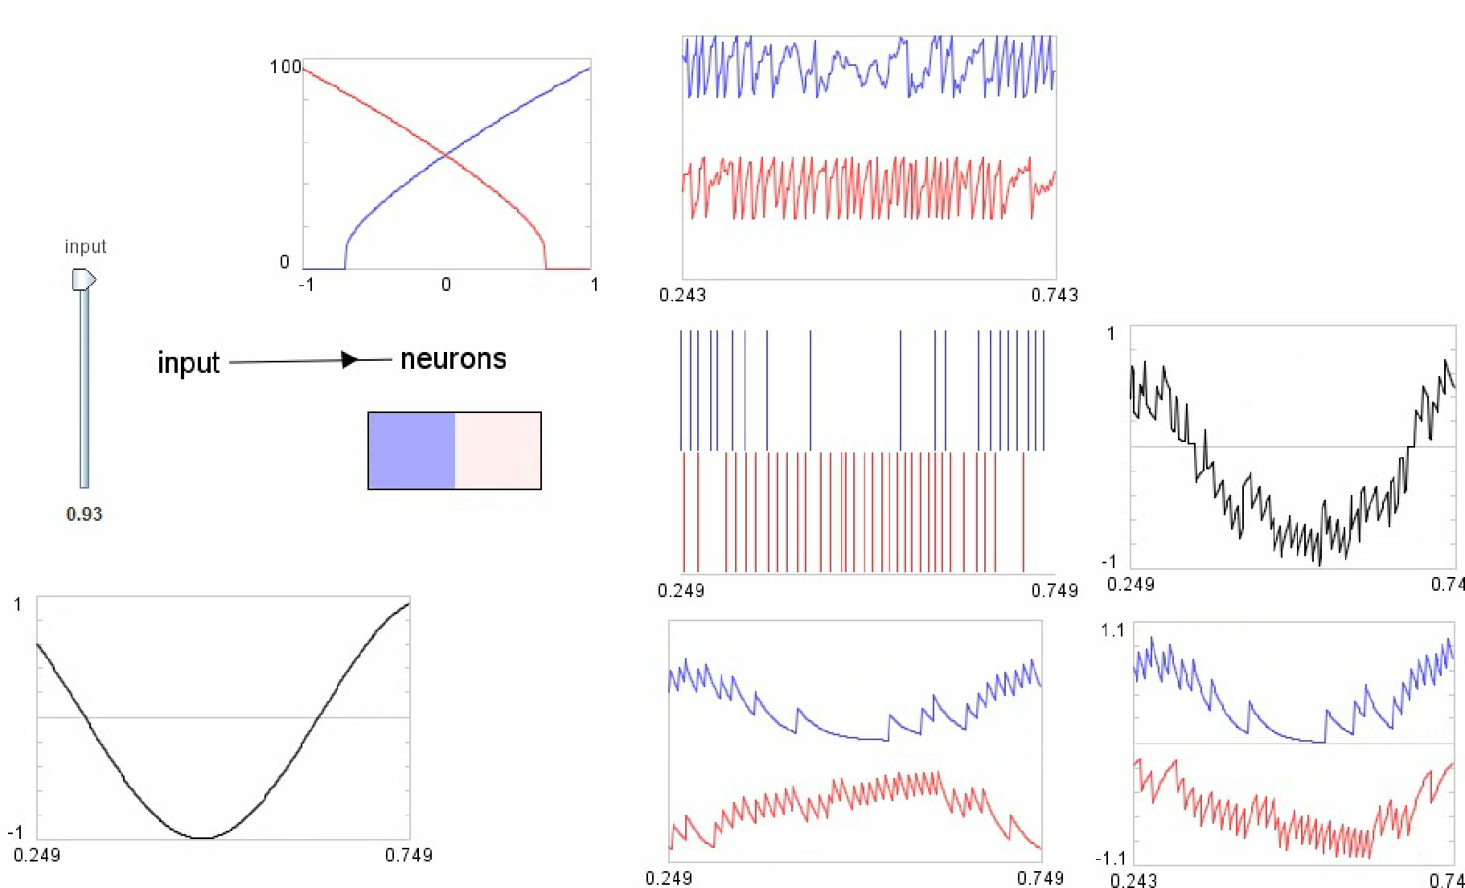
Two Neurons
Tuning Curves
Output
Input

Slide 8
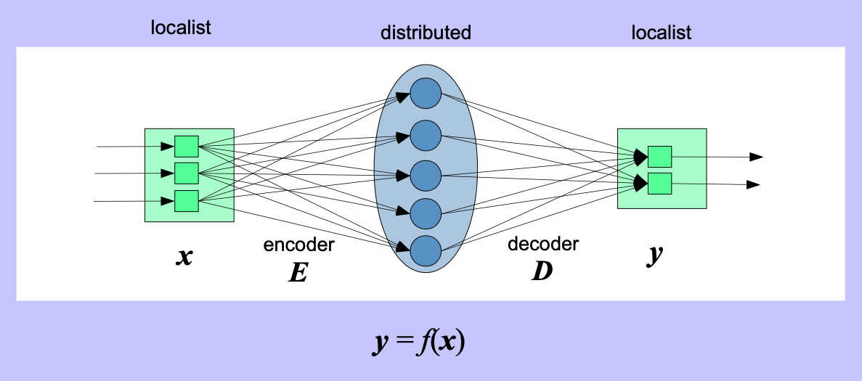
What are we actually doing?

Slide 9
Timing without explicit clock
Observation: we generally have a good sense of what happened in the very recent past
Therefore, our current cognitive state does not only represent the “now” but also the past few (?) seconds
How can we do this, and can we use it for time perception?

Slide 10
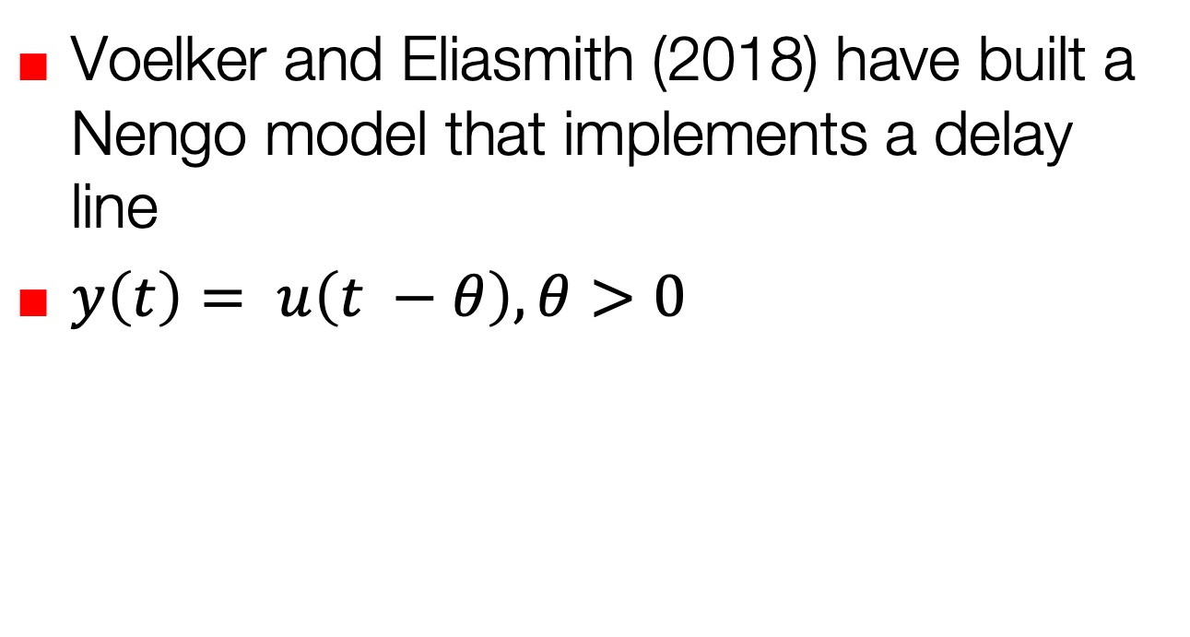
Delay-line networks
Voelker and Eliasmith (2018) have built a Nengo model that implements a delay line
$y\left(t\right)= u\left(t −θ\right), θ>0$

Slide 11
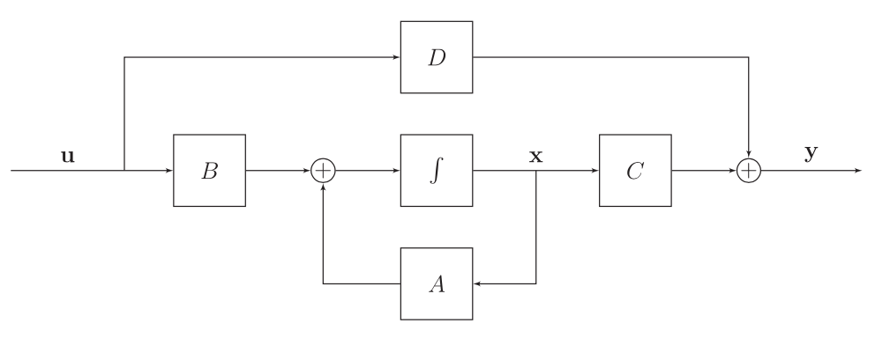
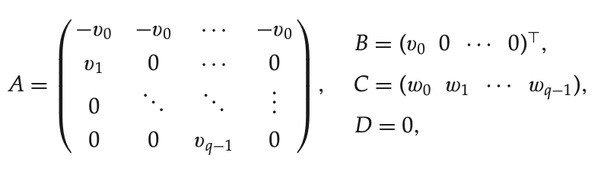
Solve this
This represents everything that happened in the last theta seconds!

Slide 12
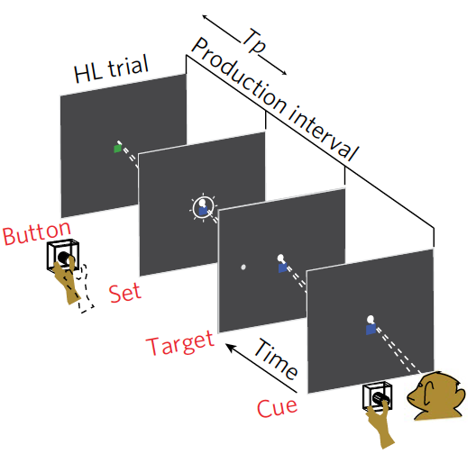
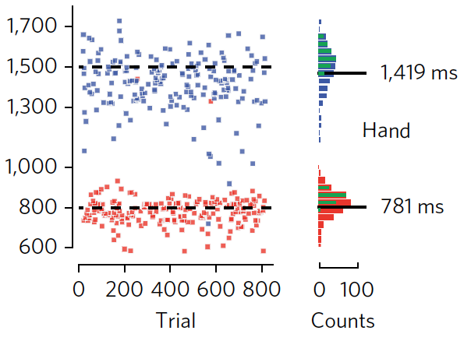
Neural activity during production (Wang et al., 2018)

Slide 13
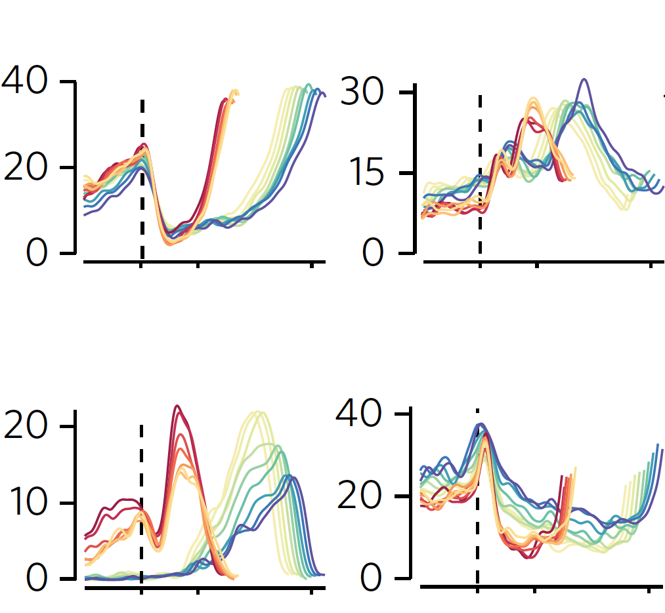
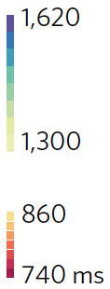
Neural activity during production (Wang et al., 2018)
Wang et al. (2018) Model
Notes:
Trials are binned according to the time production. We observe diverse response profiles. Individual neural responses are stretched (for long intervals) or compressed (for short intervals).

Slide 14
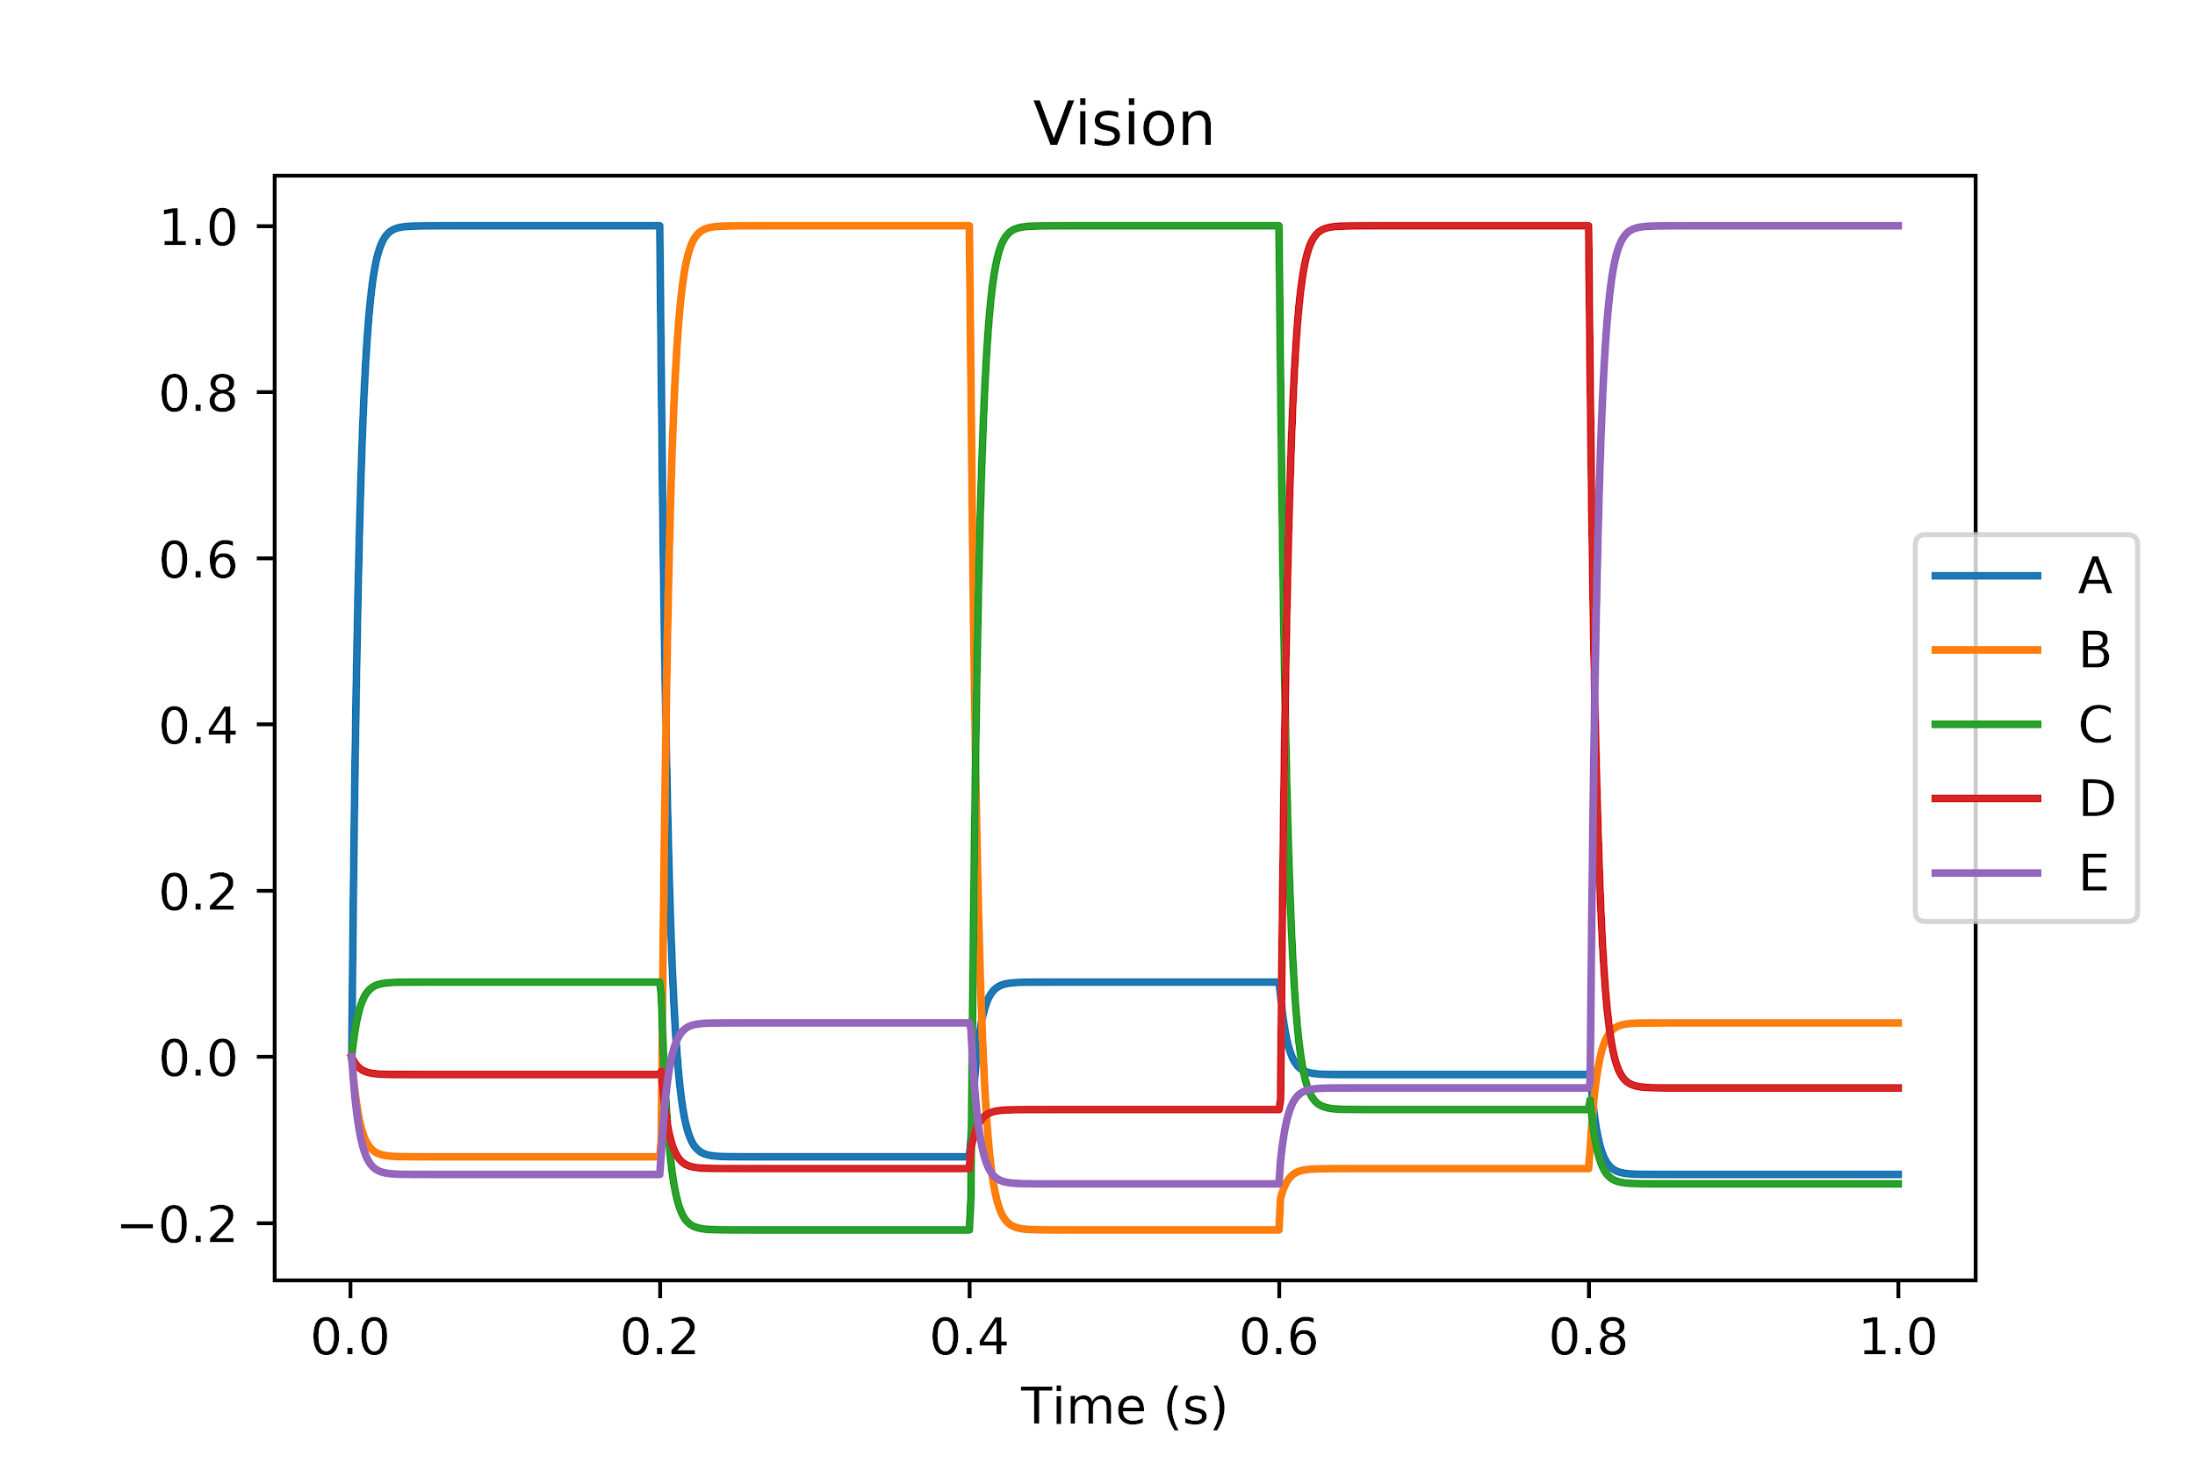
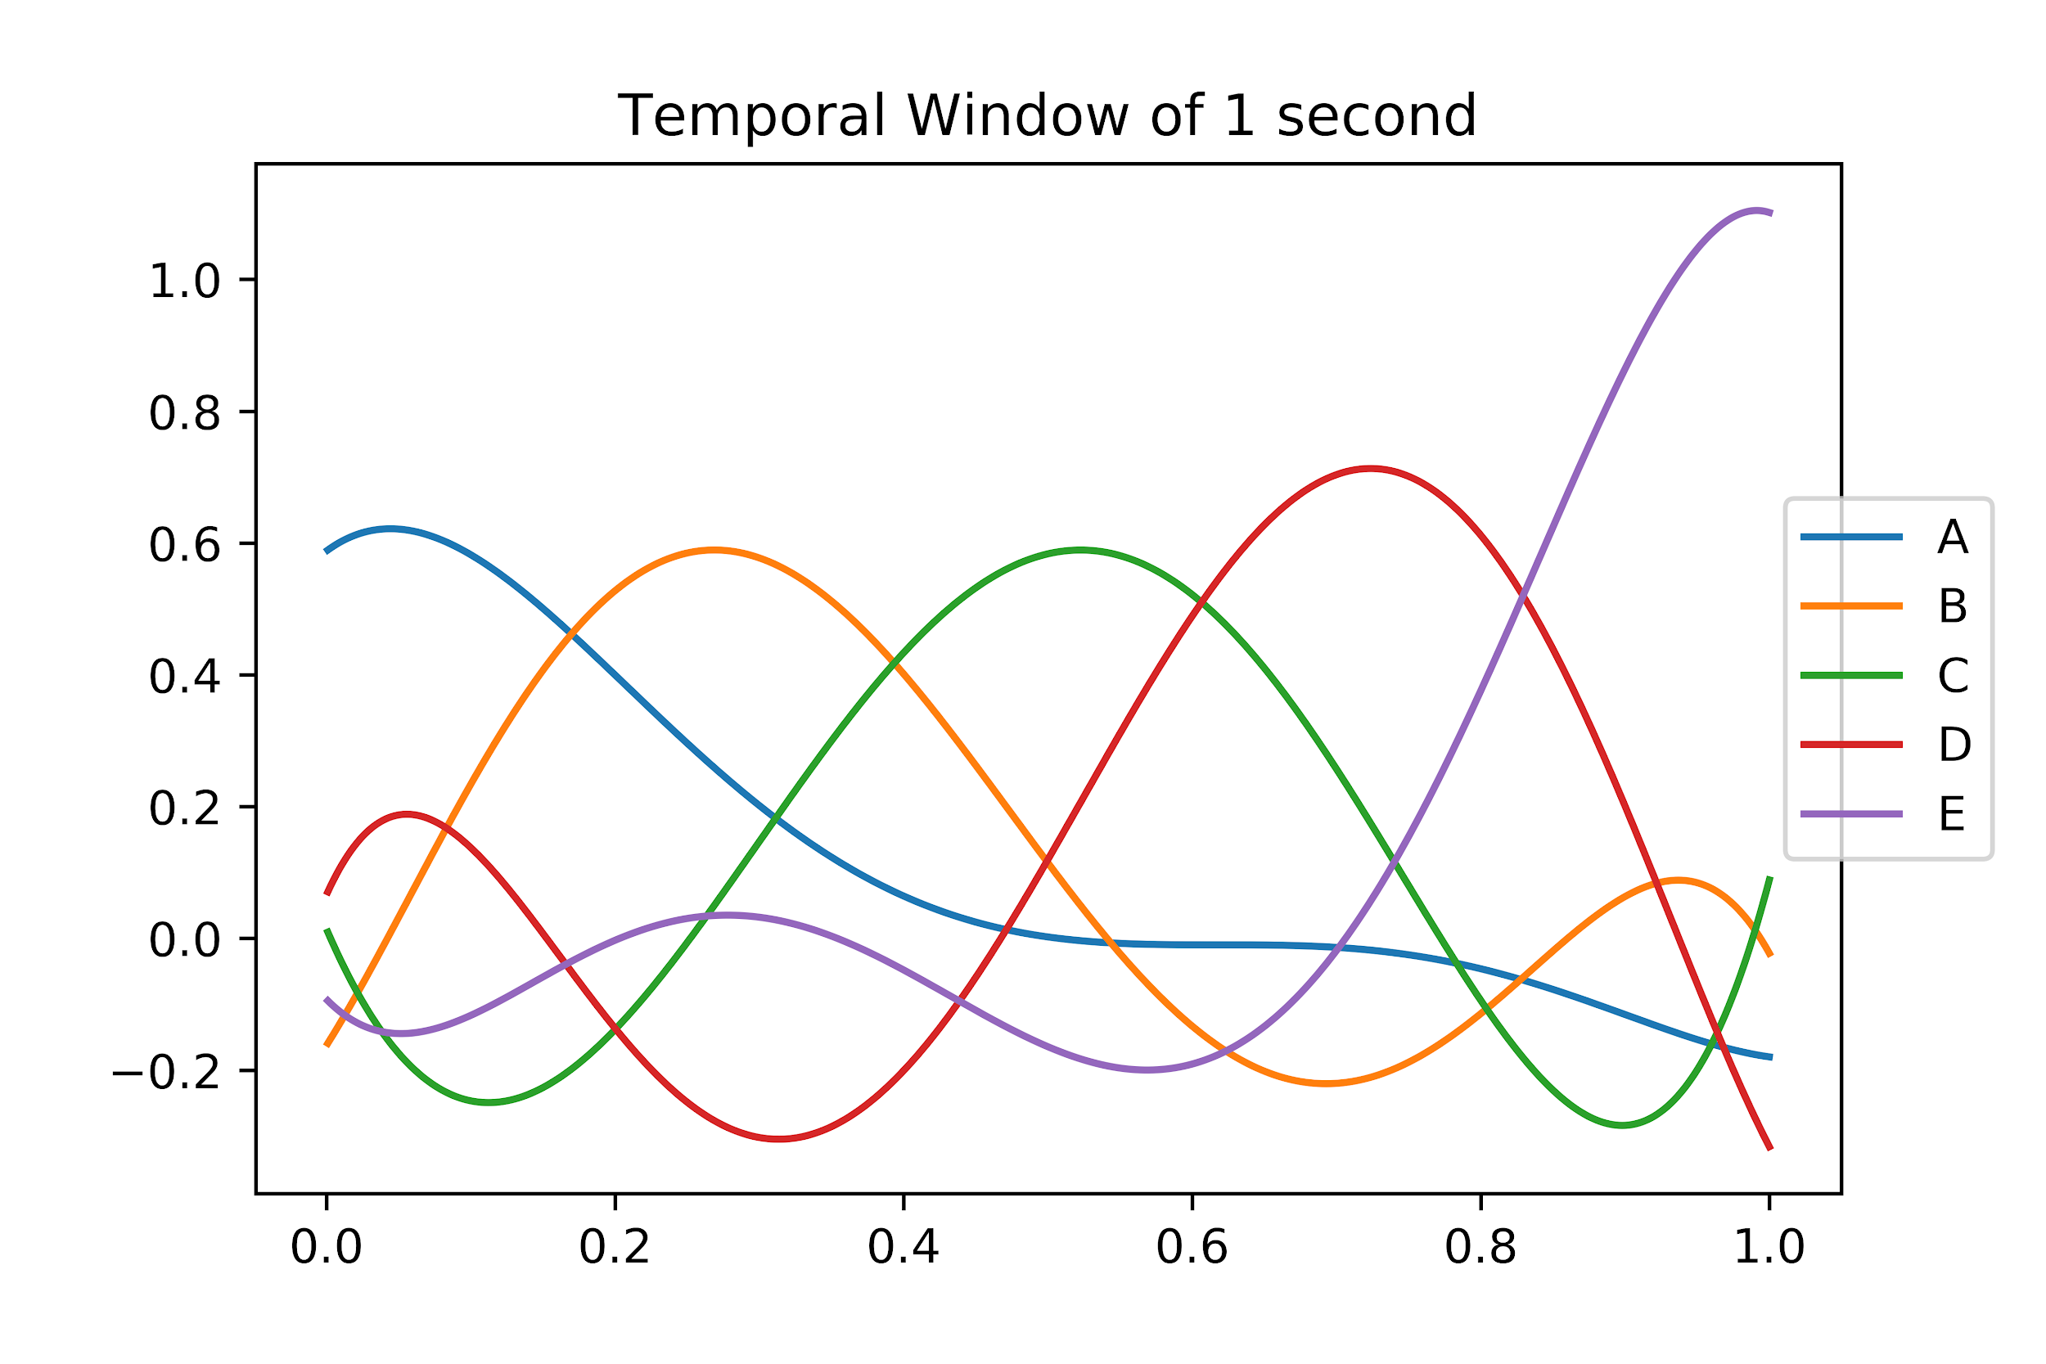
Retrospective judgements
The network maintains a rolling window of its input history:
New inputs are encoded
And continually updated how long ago they happened

Slide 15
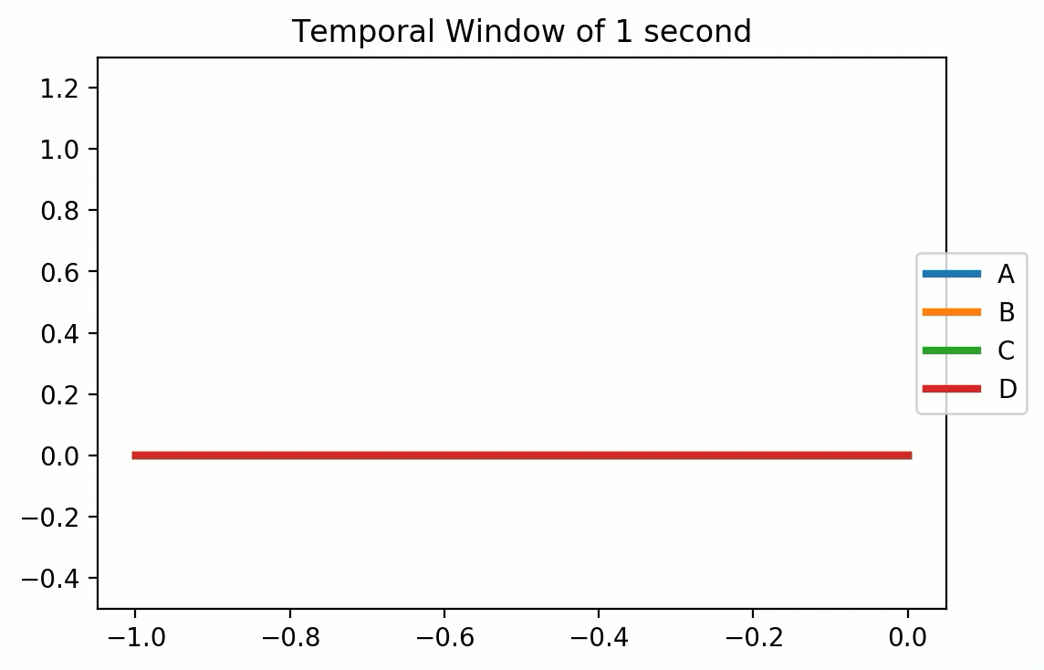

Slide 16
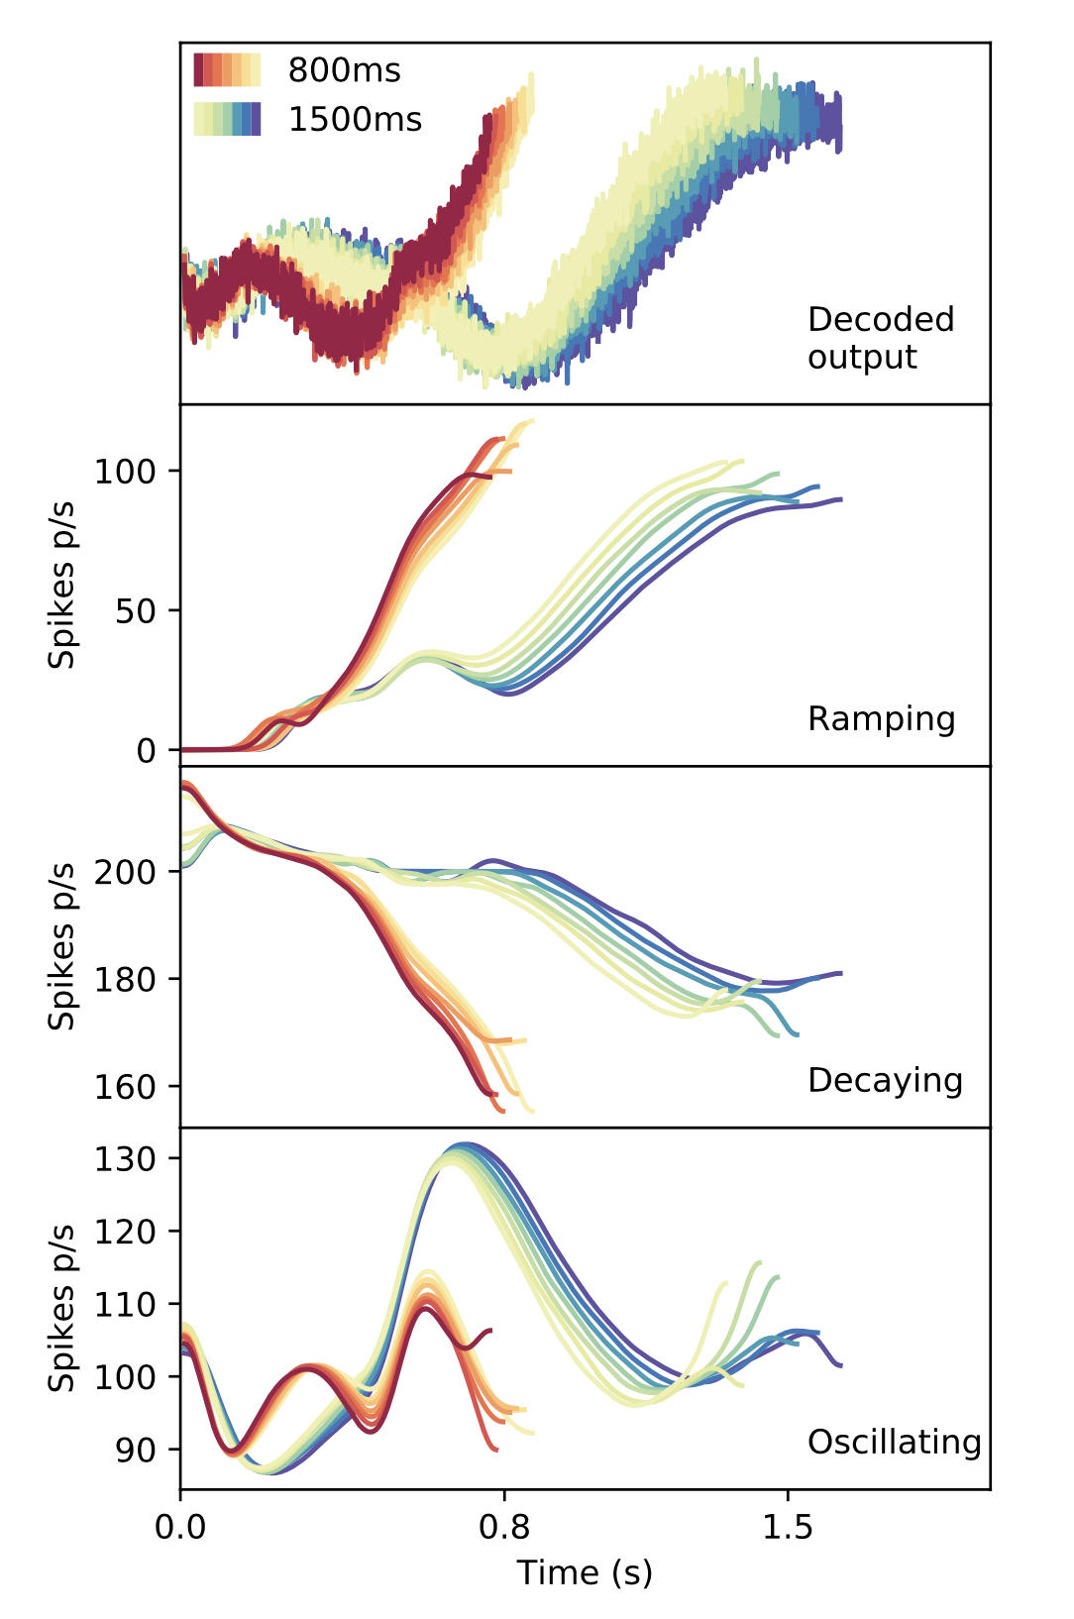
Fit with the Wang et al. data

Slide 17
Summary
Dynamical neural networks can represent time implicitly
It opens the possibility of retroactive time perception
It may also integrate with other aspects of cognition

